Slide 1
MediCall
Fall 2018: BME Senior Design
Deepthi Nacharaju
Lizbeth Leapo
Haeryn Kim

Slide 2
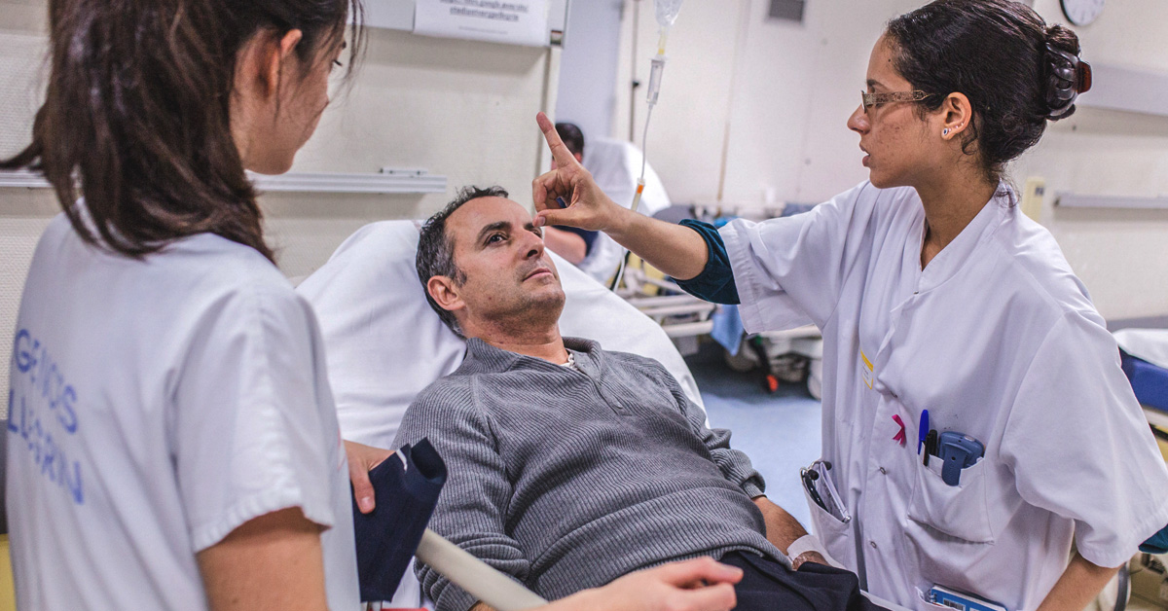
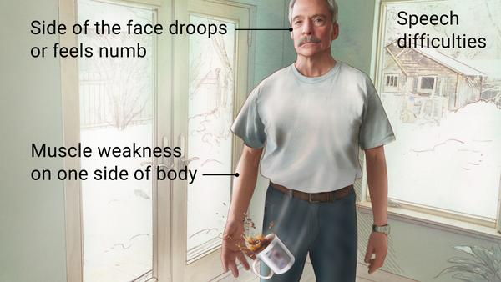
Clinical Need
Stroke patients:
Paralysis
Visual impairments
Speech impairments
Cognitive impairments
How can these patients contact nurses?
Notes:
-hospital is really scary, nurses and doctors coming in and out
-stressful for stroke patients
- stroke occurs when blood flow to certain part of brain is cut off
- every hospital room is equipped with patient-to-nurse call bell system that alleviates stress
- unfortunately, stroke patients with these disabilities have trouble

Slide 3
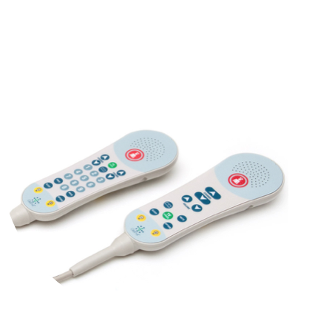
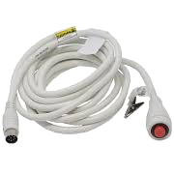
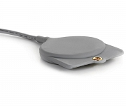
DUKE NEUROCRITICAL UNIT
Major Problems:
Too sensitive
Not plugged in
No feedback
Notes:
First call bell- incorporated into TV remote- red button alerts nurse
Mainly for patients with intact cognittive and motor skills- however, it can be hard to differentiate for blind patients
They already have some adapted call bells in place for ppl with limited hand mobility
Second is single-push call bell which is easier to grip and use. Only problem is no place to keep it
Third is for people with least dexterity. . Patients can push this button with their palm with very little force. For that reason, it tends to be extremely sensitive.

Slide 4
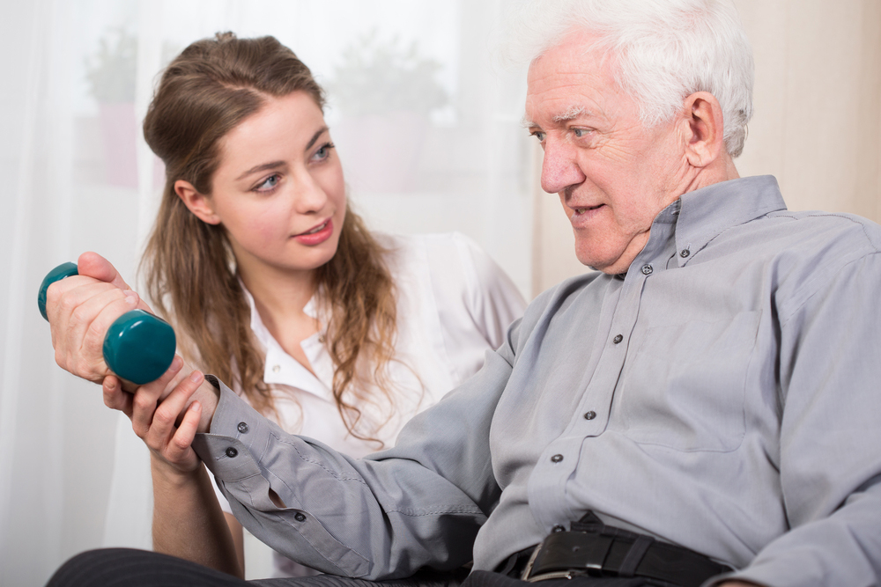
NEED
A way to address inadequate patient-to-nurse communication in patients with limited hand mobility
OUTCOME
Increases accessibility to assistance
Reduces the amount of false alerts
Notes:
Medicall is a wireless, sensor based call bell that is activated when patients rest their hand on it for 5 seconds. It is clearly labeled, and will be labeled with brail for visually impaired patients.

Slide 5
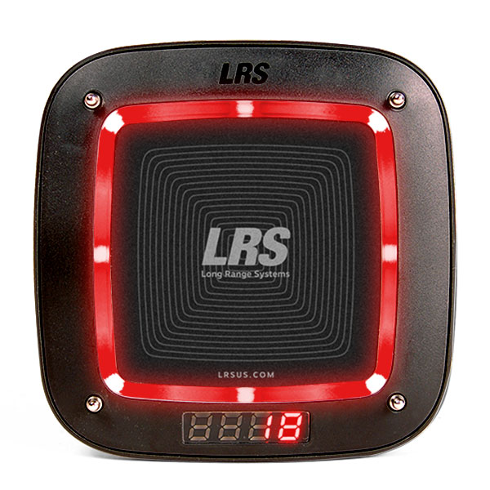

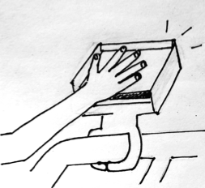
OUR SOLUTION
Easy
Sensor-based- must rest hand for 5 seconds
Quick
Immediate wireless alert to nurse
Accurate
Light and vibration feedback
Accessible
Flexible cord to attach to bedside
Notes:
Medicall is a wireless, sensor based call bell that is activated when patients rest their hand on it for 5 seconds. It is clearly labeled with the word NURSE and a pitture, and will be labeled with brail for visually impaired patients.

Slide 6

Specifications
Time it takes patient to find and use the device
Percentage of false positives
Wires from device to power
Number of different settings/modes to adapt to varying hand dexterities
Transmission Range
Battery Life
Water Resistance
Cost of Device
Weight of Device

Slide 7
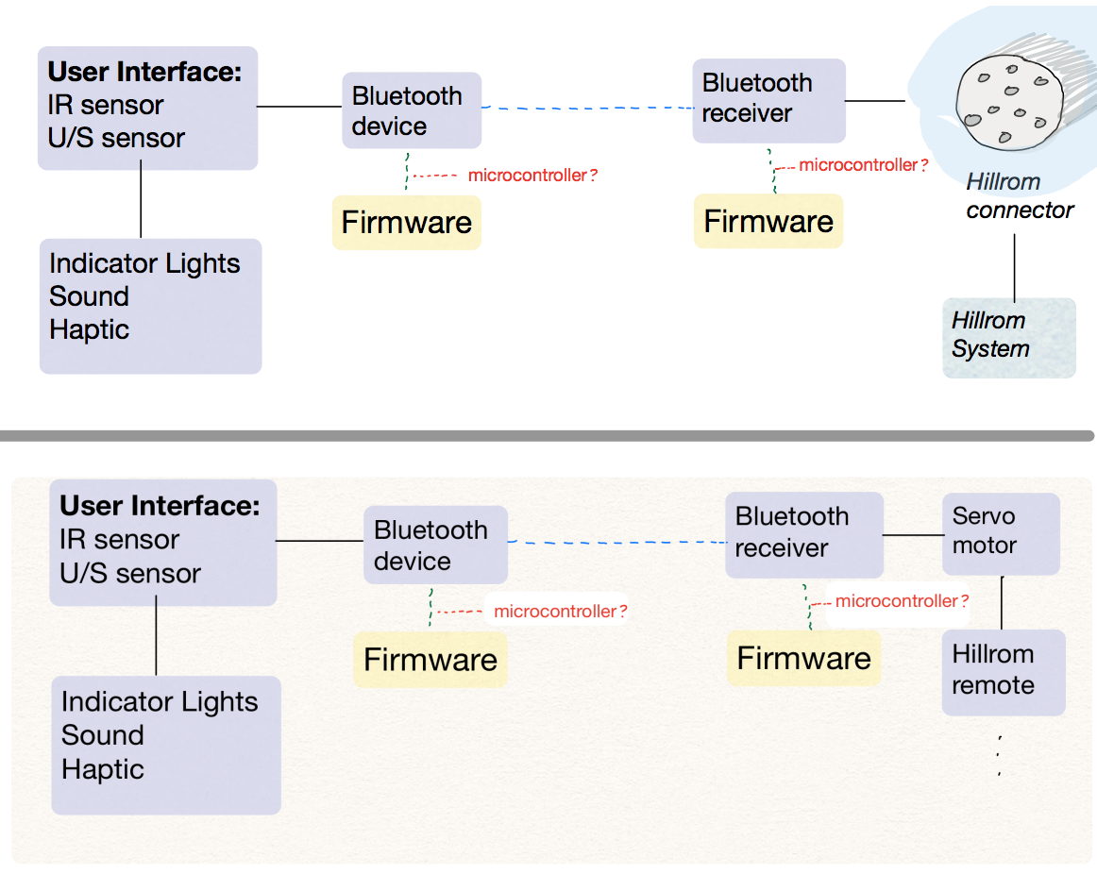
Objectives: Functional Decomposition
Objective 1

Slide 8
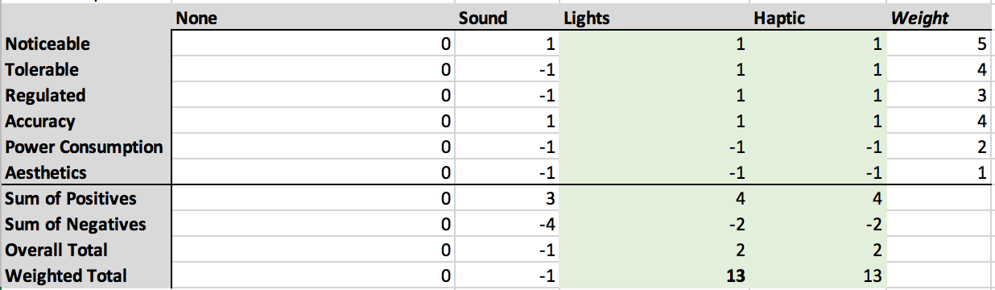
Objectives: User Alert
Objective 2

Slide 9
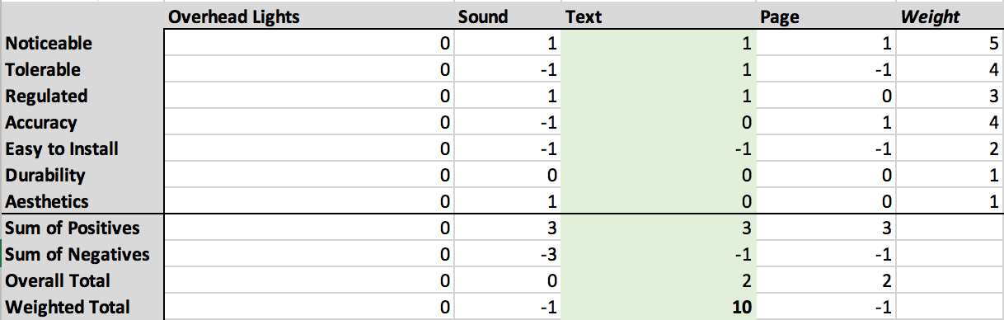
Objectives: Nurse Alert
Objective 3

Slide 10
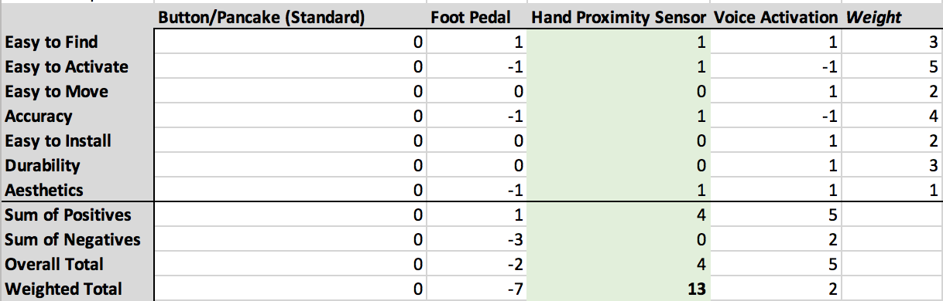
Objectives: User Input
Objective 4

Slide 11
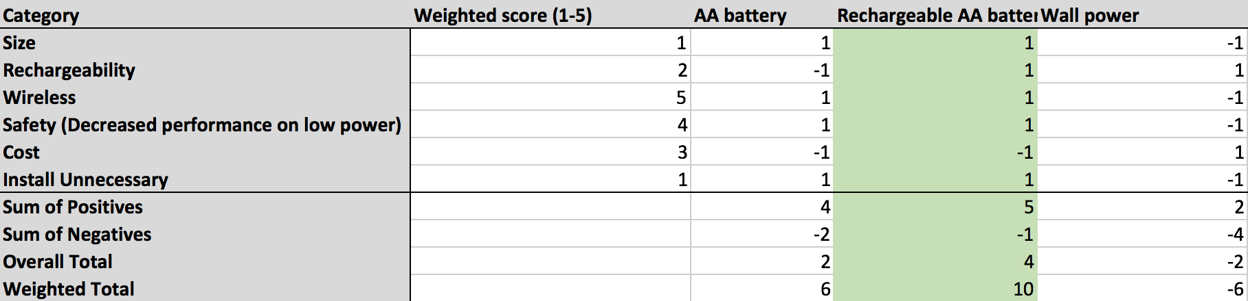
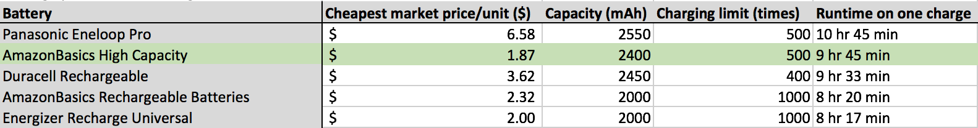
Objective 5
Objectives: Battery v Main Wall Power

Slide 12
Objectives: Bluetooth and Wi-fi Regulations
Objective 6
The hospital currently..
“[uses] analytics tools and other third party technologies … to collect non-individual information in the form of various usage and user metrics when the user employs these services.”
Duke Health Notice of Privacy Practices
Our device does not generate protected health information as defined in HIPAA Part 164 Security and Privacy Subpart C.

Slide 13
Objectives: Bluetooth and Wi-fi Regulations
Objective 6
On general security of wireless signal and data, our device must provide:
Access control
Encryption
HIPAA-compliant Wi-fi satisfies Administrative (office processes and policies), Physical (security lock) and Technical (encryption, securing WLAN traffic) Requirements.
Bluetooth Security: Provides 128-bit SAFER+ encryption and authentication. Controllable discovery and connection modes control access.

Slide 14
Objectives: Bluetooth and Wi-fi Regulations
Objective 6
On general security of wireless signal and data, our device must provide:
Access control
Encryption
HIPAA-compliant Wi-fi satisfies Administrative (office processes and policies), Physical (security lock) and Technical (encryption, securing WLAN traffic) Requirements.
Bluetooth Security: Provides 128-bit SAFER+ encryption and authentication. Controllable discovery and connection modes control access.

Slide 15
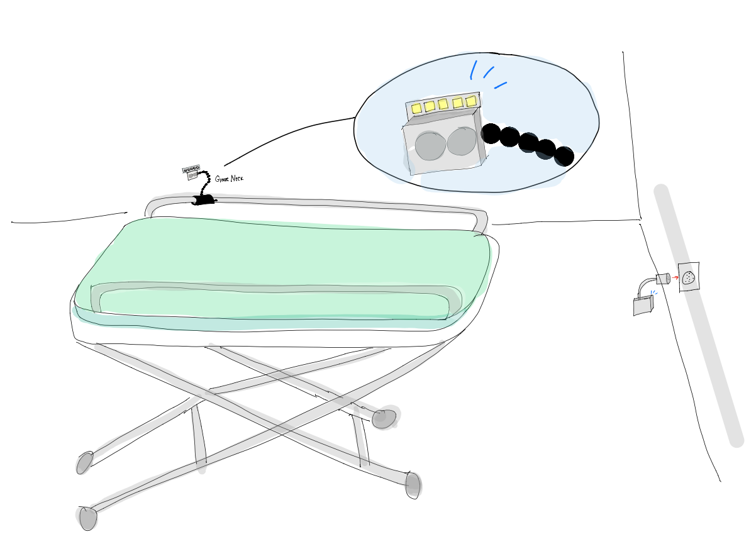
Prototyping Objectives: Drawings
Objective 7
Notes:
Liz add screenshots of solidworks files

Slide 16
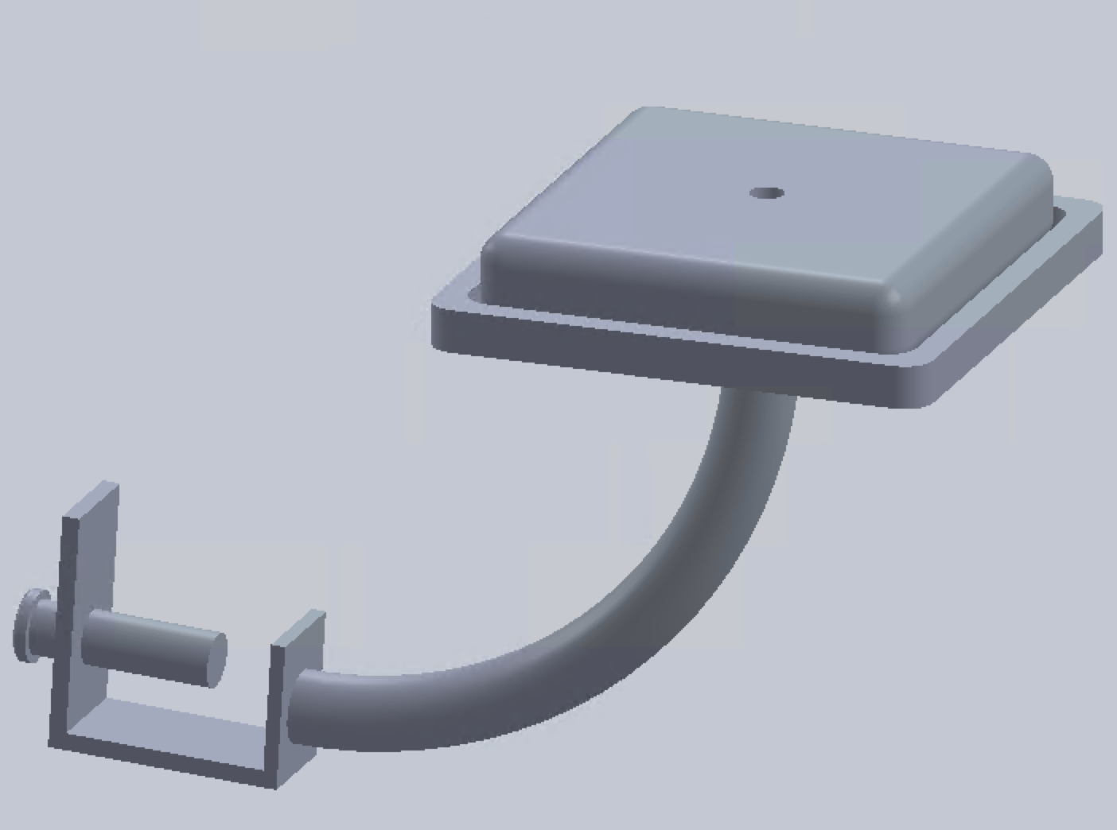
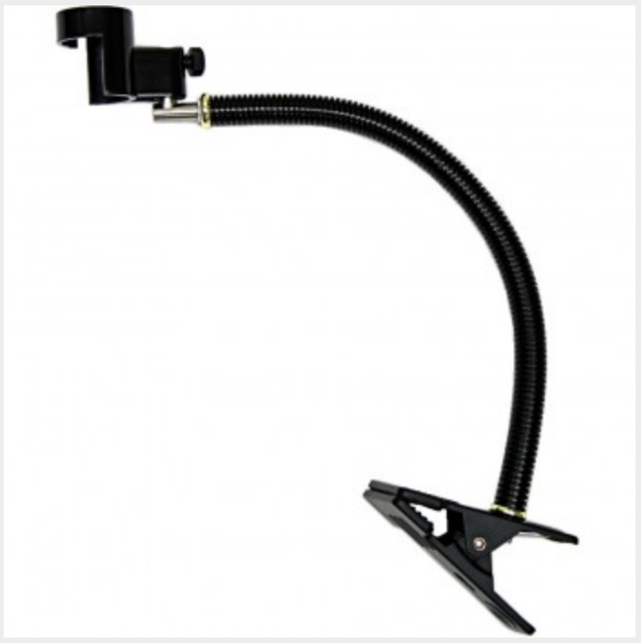
CAD Modeling:
Objective 7
- No longer detachable
- Flexible clamp- gooseneck:

Slide 17
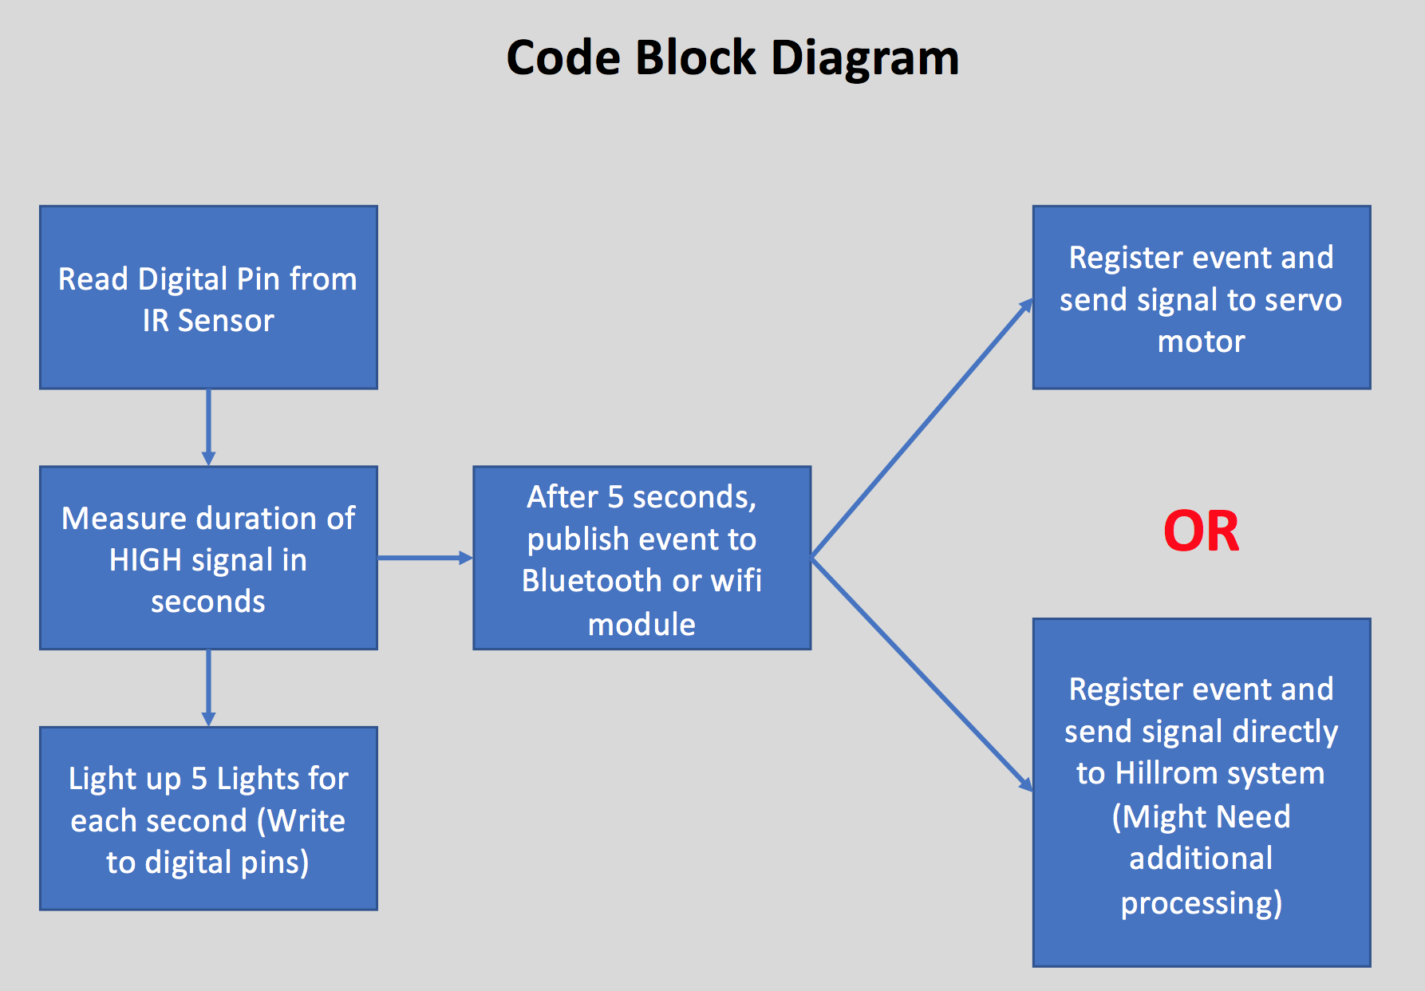
Prototyping Objectives: Code Block Diagram
Objective 8

Slide 18
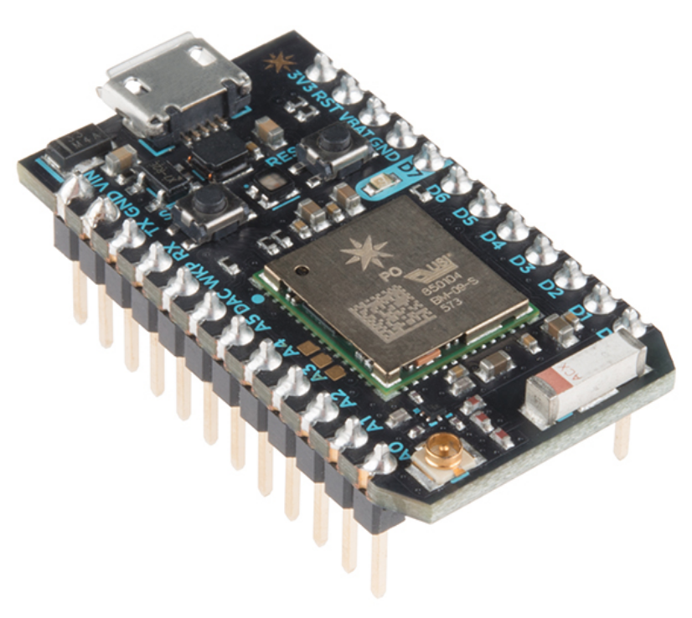
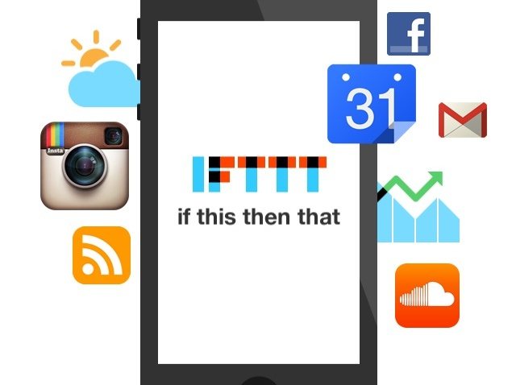
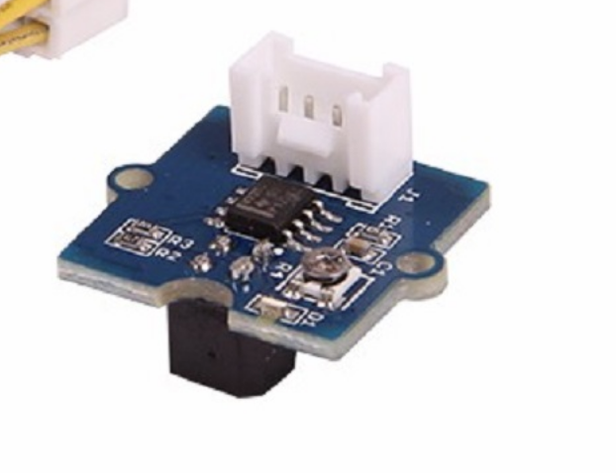
Our prototype:
Grove Reflective Infrared Sensor
Reflectivity of IR light varies with distance of reflecting surface.
Particle Photon
WiFi module connected to Duke Visitor
IFTTT
App that sends us “MediCall device activated” when IR sensor is touched for 5 seconds.

Slide 19
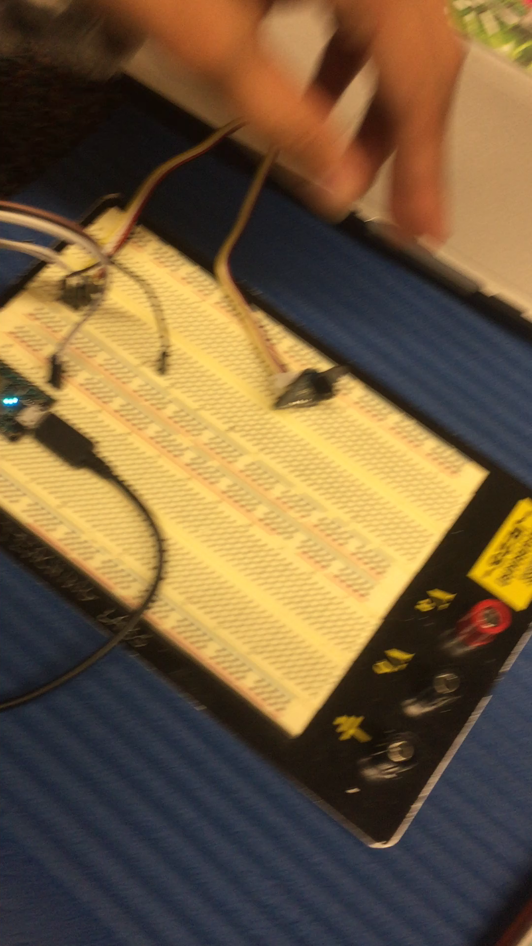
Prototyping Objectives: Working Device
Objectives 9 and 10

Slide 20
Future Steps
* Use a Bluetooth board to connect reliably to Grove IR sensor
Determine most effect text notification mechanism
Finalizing servomotor
Electrical and Mechanical CAD
Have a working prototype to implement and test

